Slide 2
Azure Service Fabric for Developers
B874
Jeffrey Richter
software engineer
Mark Fussell
program manager

Slide 3




Why a microservices approach?
Continually evolving applications
Faster delivery of features and capabilities to respond to customer expectations
Build and operate a service at scale
1
4
Monitor + Learn
Plan
Development
Production
2
3
Release
Develop + Test

Slide 4


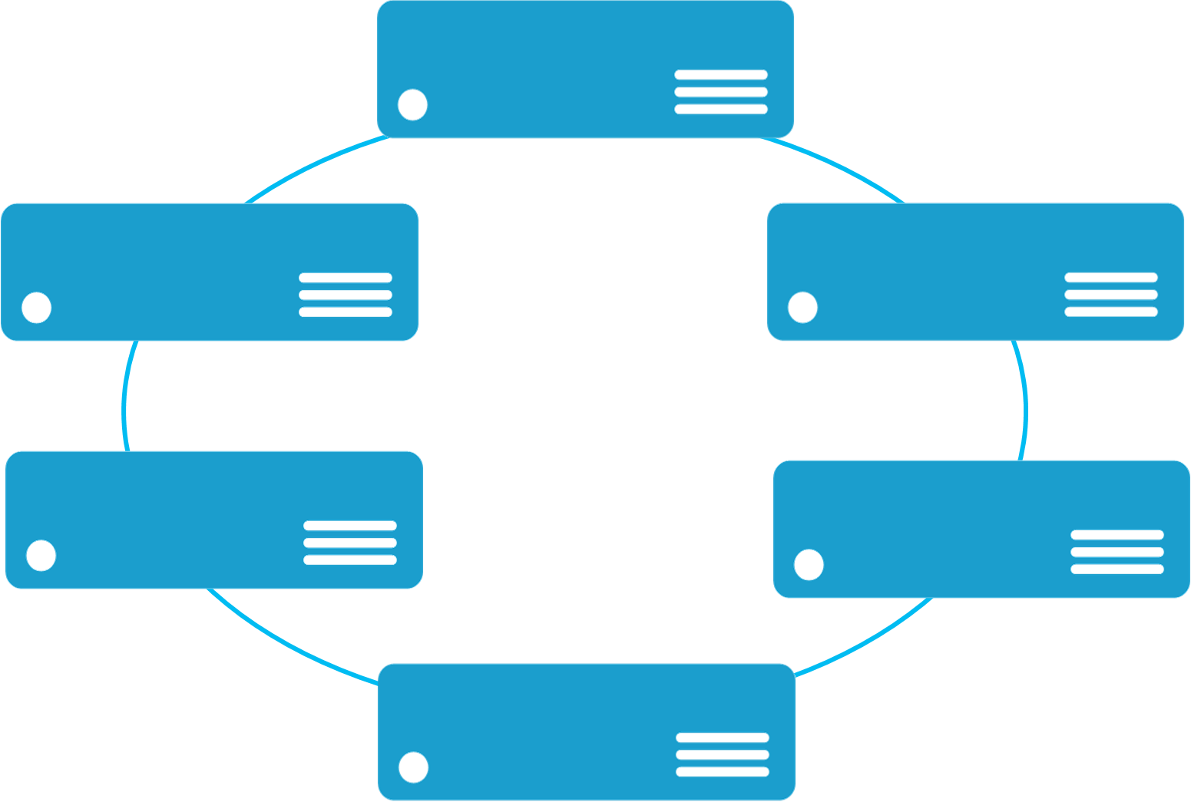


Monolithic application approach
Microservices application approach
A monolith app contains domain specific functionality and is normally divided by functional layers such as web, business and data
App 1
App 1
App 2
A microservice application separates functionality into separate smaller services.
Scales by cloning the app on multiple servers/VMs/Containers
Scales out by deploying each service independently creating instances of these services across servers/VMs/containers

Slide 5
Microservices
Build Applications with many Programming Frameworks and Languages
Microservices Platform
Deploy and Manage Applications to many Environments

Slide 6
Azure Service Fabric
LifecycleMgmt
Independent Scaling
Independent Updates
Always On Availability
Resource Efficient
Stateless/
Stateful
Public Cloud
On Premises
Private cloud
Other Clouds

Slide 7

Service Fabric Cluster
Datacenter (Azure, On Premises, Other Clouds )
PC/VM #2
Service Fabric
Your code, etc.
PC/VM #3
Management to deploy your code, etc. (Port: 19080)
Service Fabric
PC/VM #1
Your code, etc.
Service Fabric
PC/VM #4
Load Balancer
Your code, etc.
Service Fabric
Your code, etc.
PC/VM #5
App Web Request (Port: 80/443/?)
Service Fabric
Your code, etc.

Slide 8
Service Fabric Auction App
Microservices design
Application Type: sfAuction
Service Type: Website Guest Executable (stateless) (Node.js)
Service Type: APIGateway Reliable Service (stateless) (C#/.NET)
Service Type: Auction Reliable Collections (stateful) (C#/.NET)

Slide 9
Demo
SF Auction
Visual Studio Solution

Slide 10
Action App in Azure
Cluster
VMSS #1 (stateless tier) NodeType=“FrontEnd”
VMSS #2 (stateful tier) NodeType=“BackEnd”
Node #1
Node #3
Website
Auction
Load Balancer
ApiGateway
Node #2
Node #4
Website
Auction
ApiGateway

Slide 11
Demo
Creating Service Fabric Clusters Anywhere

Slide 12
Service Fabric Platform Capabilities
All code and programming models
Fast deployment
Placement and activation
Reliability
High density
Health reporting
Coordinated upgrades
Service Type: Website Guest Executable (stateless) (Node.js)

Slide 13
Website Guest Executable & Dockers Containers ServiceManifest.xml
<ServiceManifest Name="Pkg-Svc.Website" Version="1.0.0" …>
<ServiceTypes>
<StatelessServiceType ServiceTypeName="Svc.WebsiteType" UseImplicitHost="true"/>
</ServiceTypes>
<CodePackage Name="Code" Version="1.0.0">
<EntryPoint>
<ExeHost>
<Program>node.exe</Program>
<Arguments>Server.js</Arguments>
</ExeHost>
</EntryPoint>
</CodePackage>
</ServiceManifest>
<ContainerHost>
<ImageName>myNodeImage:latest</ImageName>
<Commands></Commands>
</ContainerHost>

Slide 14
Service Fabric Platform Capabilities
All code and programming models
Fast deployment
Placement and activation
Reliability
High density
Health reporting
Coordinated upgrades
Reliable Services programming model
Service endpoint discovery
Dynamic resource balancing based on actual resource usage
Integrated application patterns e.g. Actor pattern and WebApi
Visual Studio development e.g. F5 debugging, diagnostics events, package and deploy
Service Type: Website Guest Executable (stateless) (Node.js)
Service Type: APIGateway Reliable Service (stateless) (C#/.NET)

Slide 15
Demo
SF Auction APIGateway Reliable Services (stateless)

Slide 16


State Architectures: Traditional vs Service Fabric
Stateless Web
Stateless Compute
Cache
Stateful Data
Other Internal Tiers ?
Load Balancer
Stateless Web
Stateful Compute
Load Balancer

Slide 17
Service Fabric Platform Capabilities
All code and programming models
Fast deployment
Placement and activation
Reliability
High density
Health reporting
Coordinated upgrades
Reliable Services programming model
Service endpoint discovery
Dynamic resource balancing based on actual resource usage
Integrated application patterns e.g. Actor pattern and WebApi
Visual Studio development e.g. F5 debugging, diagnostics events, package and deploy
Reliable Collections programming model
Highly-reliable and scalable state
Lower latency compared to external storage
Service Type: Website Guest Executable (stateless) (Node.js)
Service Type: APIGateway Reliable Service (stateless) (C#/.NET)
Service Type: Auction Reliable Collections (stateful) (C#/.NET)

Slide 18
Stateful Auction Service
Auction (Partition #1)
Users Dictionary
Email | UserInfo
U1 | ItemId[]
U2 | ItemId[]
U1’s Items Dictionary
ItemId | ItemInfo
U1/“A” | 2016-2-1, Bid[]
U1/“B” | 2016-2-5, Bid[]
CreateUserAsync
APIGateway
Active Items List
ItemId
U1/“A”
U2/“X”
U2’s Items Dictionary
ItemId | ItemInfo
U2/“X” | 2016-3-3, Bid[]
U2/”Y” | 2016-4-9, Bid[]

Slide 19
Demo
SF Auction
Reliable Collections (stateful)

Slide 20




















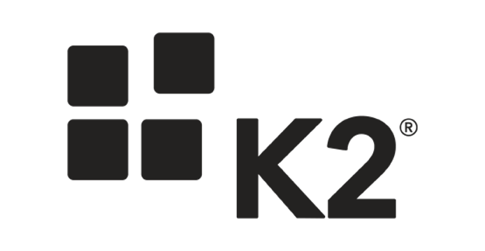
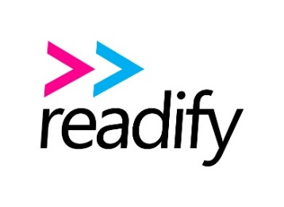









































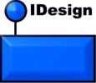










Slide 21

















Slide 22


Age of Ascent & Service Fabric
Ben Adams
CTO
Independent games studio specializing in massively multiplayer games

Slide 23


Ultra Massively Multiplayer Game
Driven by human interaction
A single contiguous universe
Without artificial boundaries
Credit: NASA, ESA, S. Beckwith (STScI), and The Hubble Heritage Team (STScI/AURA)

Slide 24
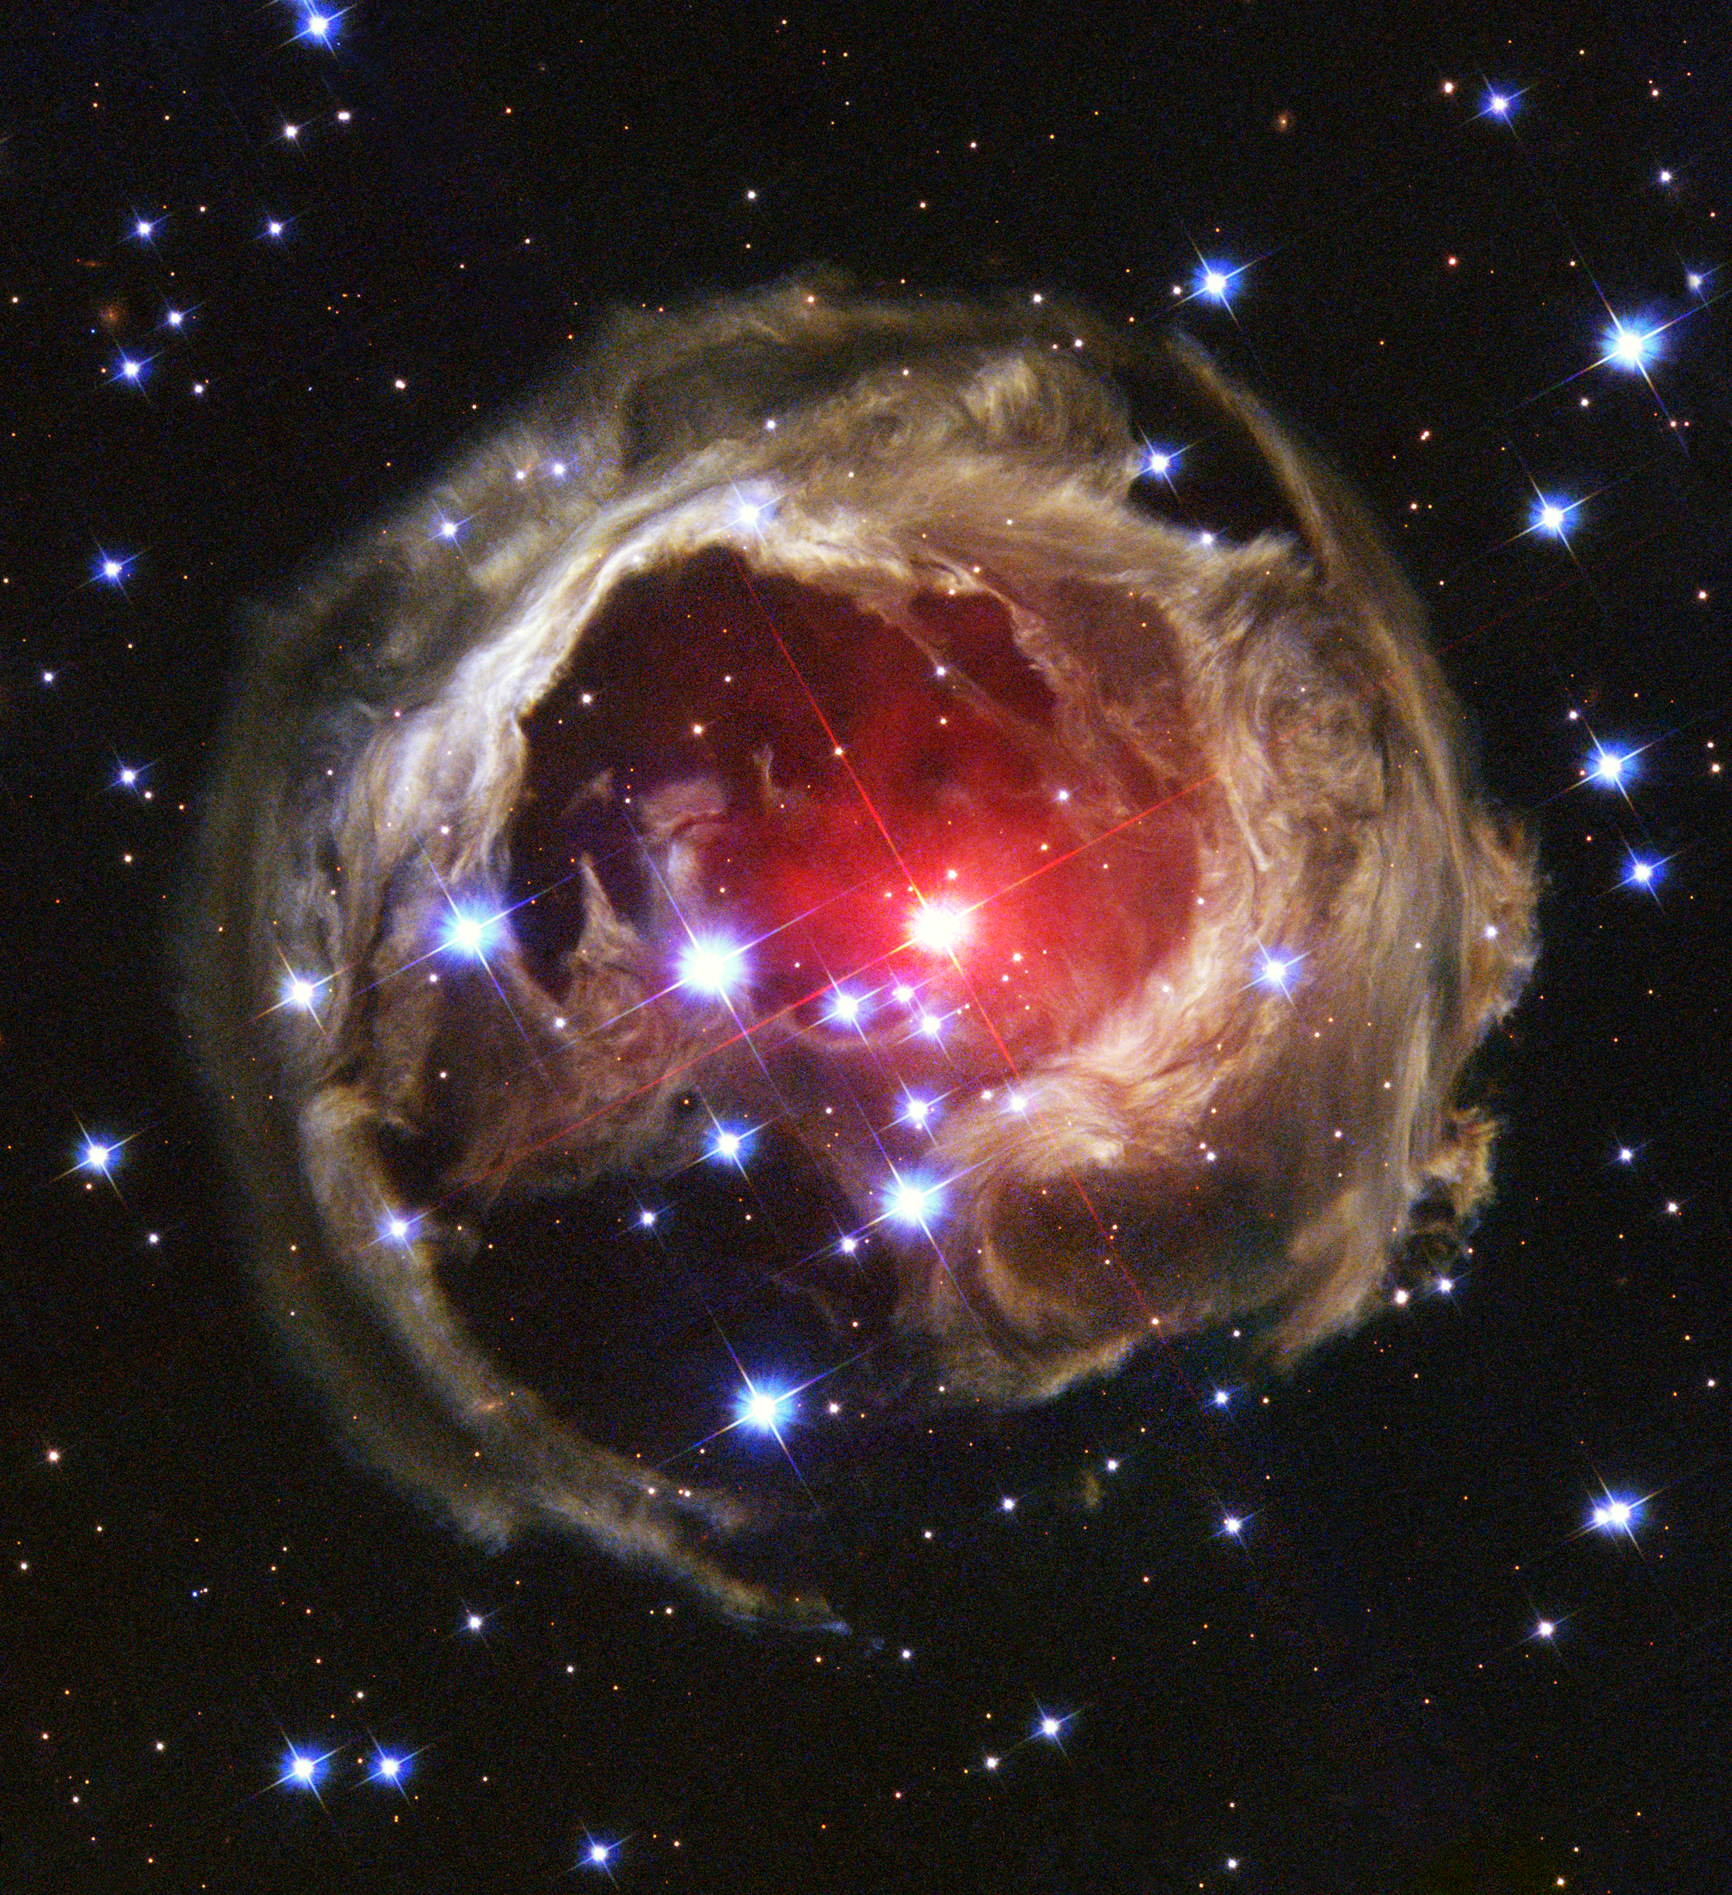
Born in the cloud
Servers are a resource
Hyper scale
High density
Cost effective
Unanticipated load handling
Fault tolerant
Seamless user experience
Always available
Individually upgradable
Data scales with compute
Credit: NASA and The Hubble Heritage Team (AURA/STScI)

Slide 25

High Performance
Empire building, economic price wars, real-time space twitch-combat.
Millions of players concurrently in single contiguous universe.
50,000+ simultaneous players, real-time in the same battle.
267 million networked application messages per second. (23 trillion per day)
Credit: ESO/L. Calçada

Slide 26


web browser
or device
Age of Ascent Architecture
CDN
Service Fabric Cluster
Gaia (stateless)
Avatar
(stateless)
32 Microservices
AI
Events
routing
services
physics
service
Account
Player
Commerce
Crew
Alliance
aggregate
services
game
function
services
Spatial
(In Space)
Trade Inventory Production
Navigation
Comms

Slide 27
Demo
Age of Ascent – Service Fabric

Slide 28
Call to Action
Come to the product booth and chat with the team
Download the Service Fabric developer SDK
http://aka.ms/ServiceFabricSDK
Download the standalone Service Fabric preview for Windows Server
http://aka.ms/ServiceFabricWS2012R2
Learn from samples and complete solutions
http://aka.ms/ServiceFabricSamples
Signup for Service Fabric on Linux
http://aka.ms/SFlinuxpreview
Provide feedback
http://aka.ms/ServiceFabricForum
Twitter HashTag
#AzureServiceFabric

Slide 29



Please Complete An Evaluation Form Your input is important!
or

